Slide 1
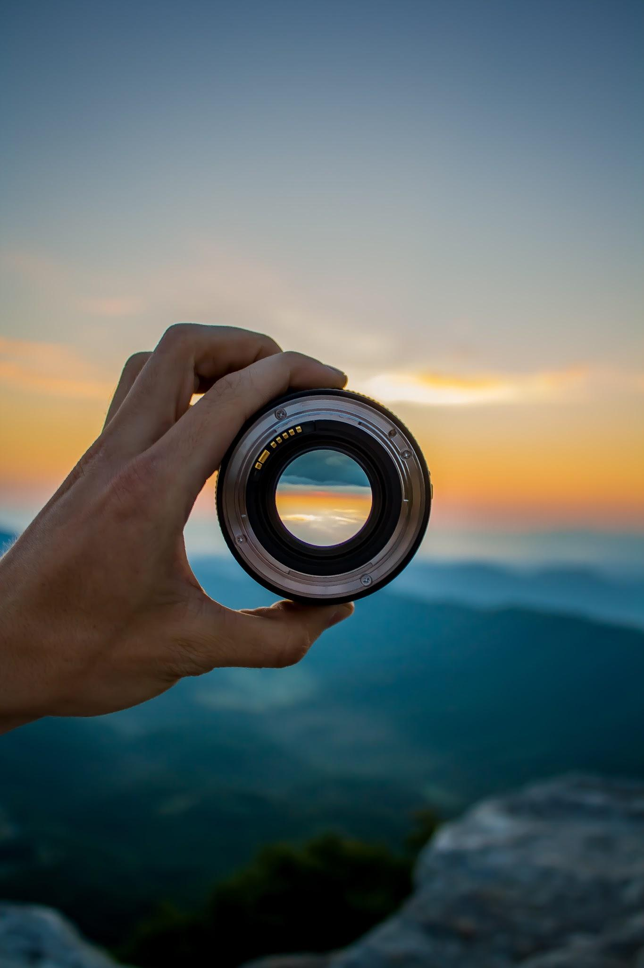
PHOTOGRAPHY STUDIO
MEMBERS:

Slide 2
PROBLEM DOMAIN
Providing an interactive platform for showcasing photography collections by category, allowing users to easily explore images, submit testimonials, and view feedback, all while seamlessly storing and displaying submissions using a backend system.

Slide 3
USER STORIES(WEB FUNDAMENTALS)
🐿️ As a user, I want the web page to have a clear structure with a recognizable header, footer, and navigation sections, so that I can easily navigate smoothly and understand the content.
🐿️ As a user, I want the website design to adjust using media queries so that it works well on both small mobile screens and larger desktop screens.
🐿️ As a user, I want the website to be visually impressive and user-friendly, so that it provides a pleasant browsing experience with easy access to galleries and testimonials.
🐿️ As a user, I want to have a “back to top” button so that I can easily return to the top without manually scrolling.

Slide 4
USER STORIES(programming logic)
🐿️ As a user, I want to view images organized into categories and be able to switch between them using buttons, so that I can easily explore the photography collections I’m interested in.
🐿️ As a user, I’d like to fill out a working testimonial form so that I can submit my feedback about the photography services effectively and without issues.
🐿️ As a user with accessibility needs, I expect accessible considerations like alternative text for images so my screen reader can interpret and convey the content to me effectively.

Slide 5
USER STORIES(programming logic continuation)
🐿️ As a developer, I want to create a working API GET route so that I can retrieve form data from the server and display it to the users in the testimonials.
🐿️ As a developer, I want to create a working API POST route so that users can submit their testimonials, and the data will be saved in the database (e.g., Supabase).
🐿️ As a developer, I want to integrate front-end components with an Express server and a Postgres database, including making Fetch calls to retrieve testimonials and handle submissions.
🐿️ As a developer, I want the submitted testimonials to be automatically displayed on the website after being stored in the database, so that the feedback appears in real-time without manual updates.

Slide 6
STRETCH GOALS
🐿️ As a user, I want to use keyboard shortcuts, like arrow keys, to switch between images easily.
🐿️ As a user on various devices, I want to view and access the images easily for an optimal viewing experience, ensuring the layout adapts based on my device’s screen size.

Slide 7
MVP
IMAGE GALLERY
CONTACT FORM
TESTIMONIAL TO VIEW FEEDBACK

Slide 8
HTML $ CSS
Structured the website layout using HTML.
Designed the site with CSS for styling and responsiveness.
Focused on creating a user-friendly interface.
Team Members: Amina, Jae, Sita

Slide 9
JavaScript for Interactivity
Added dynamic functionality to the site using JavaScript.
Features include dynamic image loading and user interactions.
Solved issues related to event handling and animations.
Team Members: Amina, Jae, Sita

Slide 10
HTTP Requests Integration & server side
Used HTTP requests to fetch and display data.
Implemented using [e.g., Fetch API or Axios].
Connected the frontend to external APIs.
Team Members: Amina ,mohammed

Slide 11
Database Integration with Postgres
Set up a PostgreSQL database to store images and user data.
Designed efficient schemas for faster querying.
Managed database connections and security.
Team Member: Mohamed

Slide 12
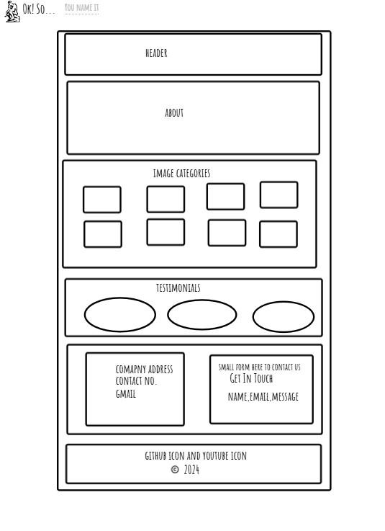
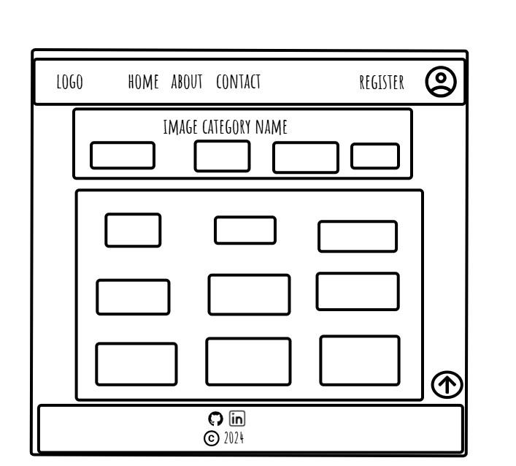
Wireframe Design

Slide 13
Project Management with Trello
• Used Trello to organize tasks and track progress.
• Each member was assigned tasks based on their expertise.
• Regular updates and feedback ensured timely completion.
• Screenshot of Trello board: [Add image if needed].

Slide 14
DEMO

